Slide 1
Predicting the house prices with a linear regression model
Claudia Stangarone - Mid-BootCamp Project
Iron Hack

Slide 2

Case Scenario and Objective
Explore the characteristics of the houses using some business intelligence tools.
Understand which factors are responsible for house prices > $650K
predict the price of a house based on features provided
Notes:
A company wants to build a machine learning model to predict the selling prices of houses based on a variety of features on which the value of the house is evaluated.

Slide 3
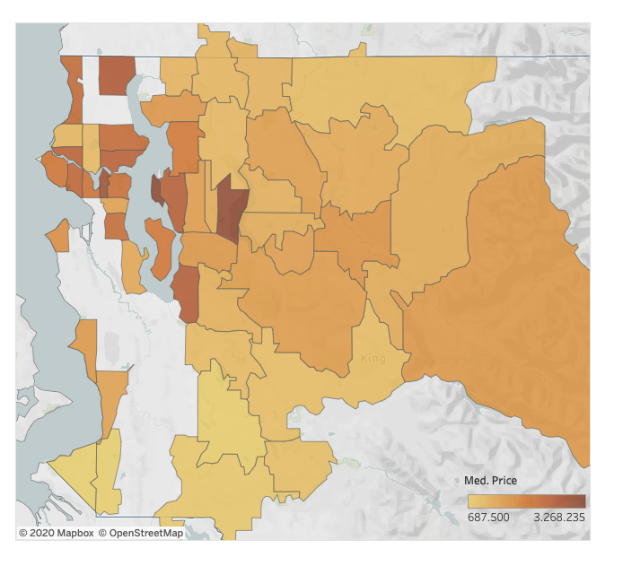
Distribution of the houses in the county per zip code and relative average price
It looks like the most expensive houses are concentrated around the waterfront.

Slide 4
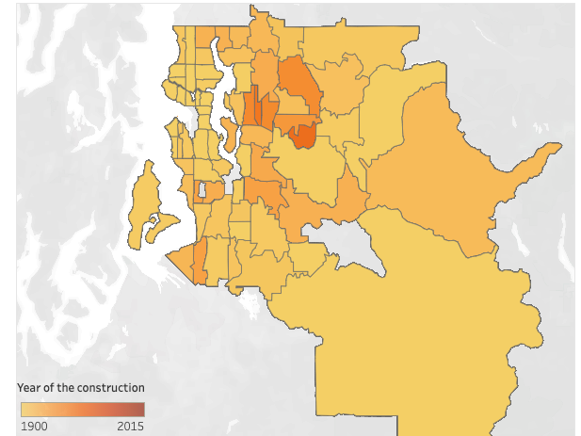
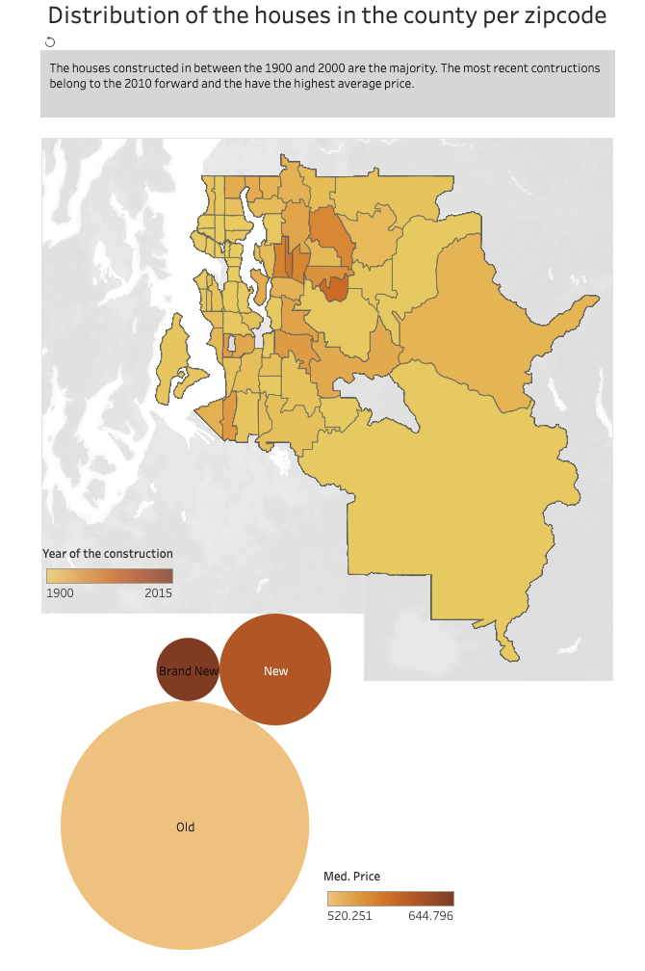
Distribution of the houses in the county subset by year of construction
The houses constructed in between the 1900 and 2000 are the majority. The most recent constructions belong to the 2010 forward and the have the highest average price.

Slide 5
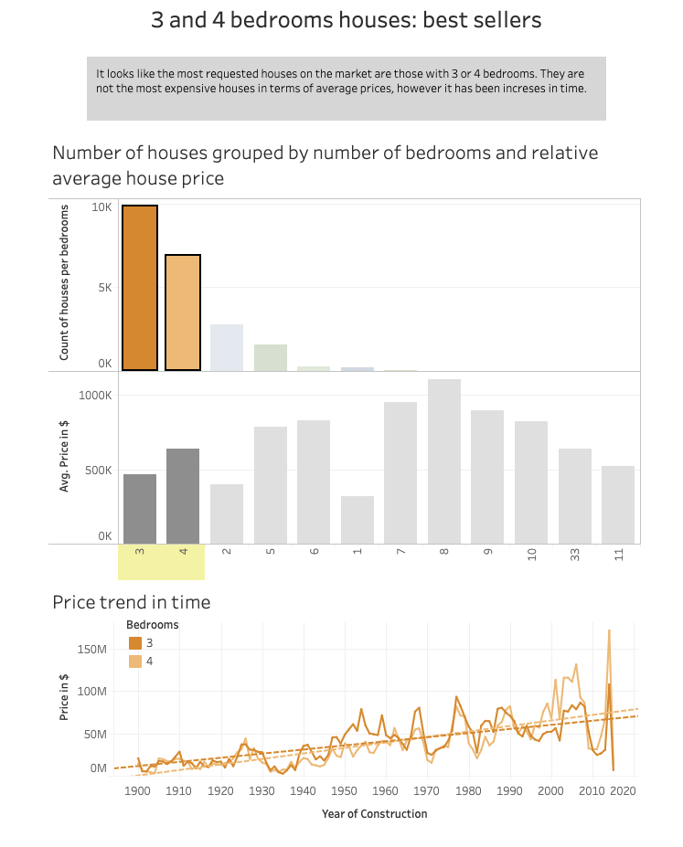
3 and 4-bedroom houses: best sellers

Slide 6
3 and 4-bedroom houses: best sellers
It looks like the most requested houses on the market are those with 3 or 4 bedrooms. They are not the most expensive houses in terms of average prices, however it has been increases in time.

Slide 7
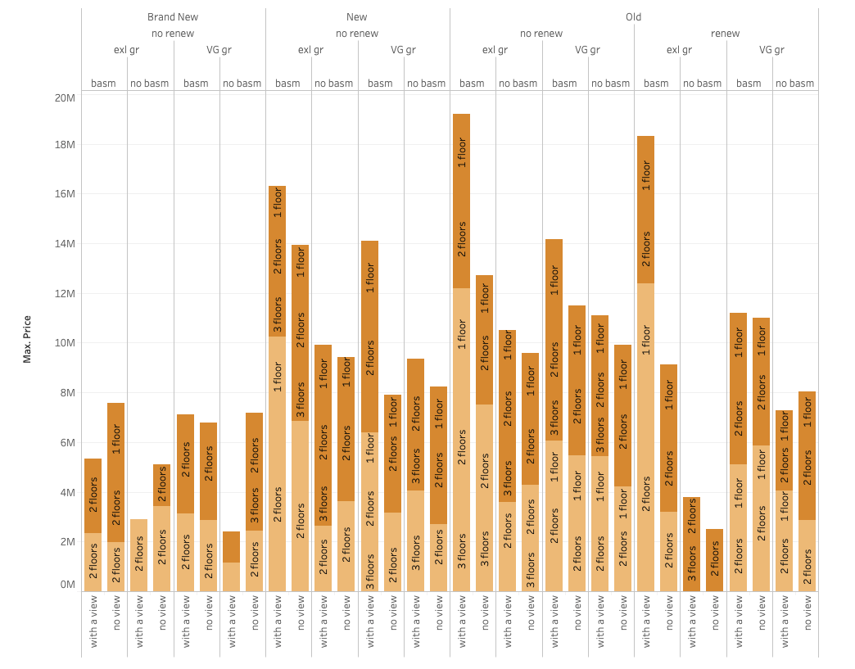
Features of the most expensive houses
The most expensive houses have been constructed in between the '70s and the '90s, they have one floor, they are not renovated, they have a basement, with an excellent grade by the county and with a beautiful view.

Slide 8
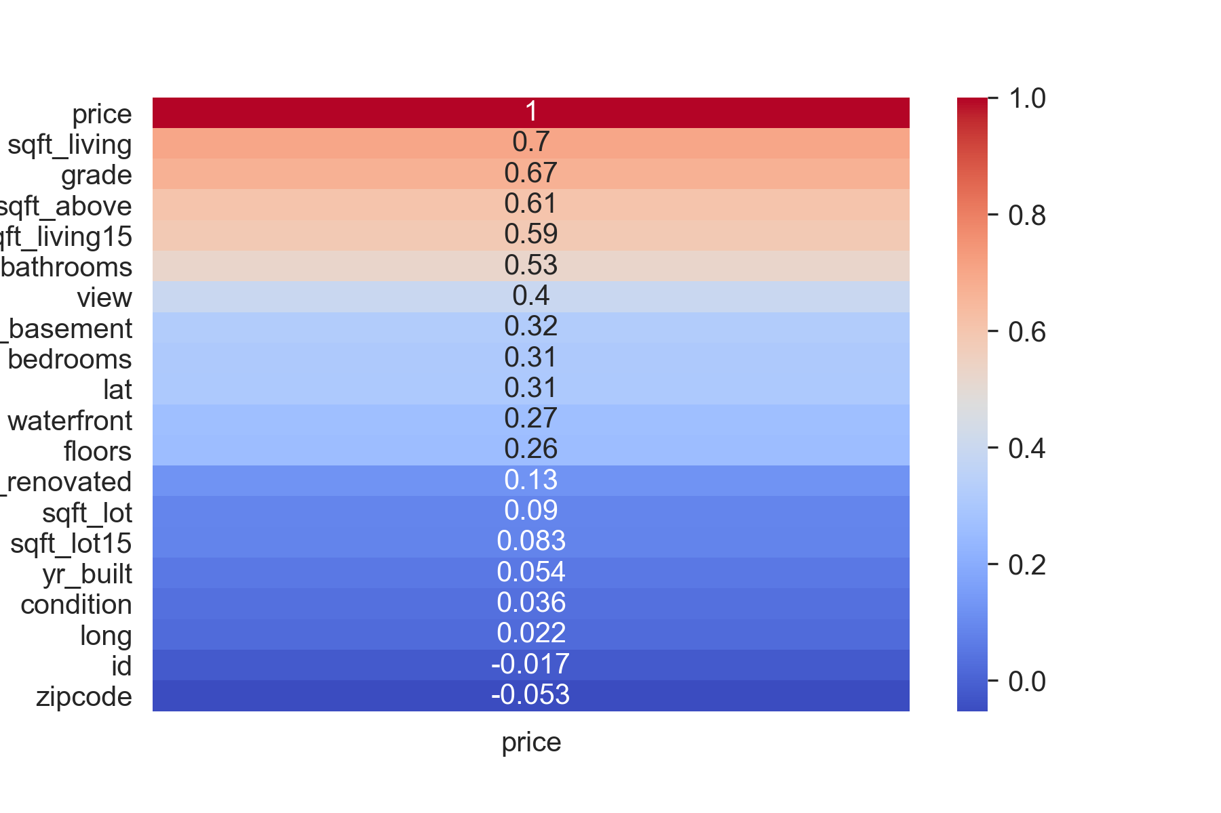
Independent variables used and why
'Sqft_above': square footage of house apart from the basement
'Sqft_living15': Living room area in 2015(implies-- some renovations)
'Bathrooms': n.of Bathrooms
'View': if it has a view
'Sqft_basement': square footage of the basement
'Floors': how many floors (ranging from 1 to 3)
'Grade': given by the King County
'Condition: How good the condition is (Overall). 1 indicates worn-out property and 5 excellent.
'Yr_built': year of construction ranging from 1900 till 2015

Slide 9
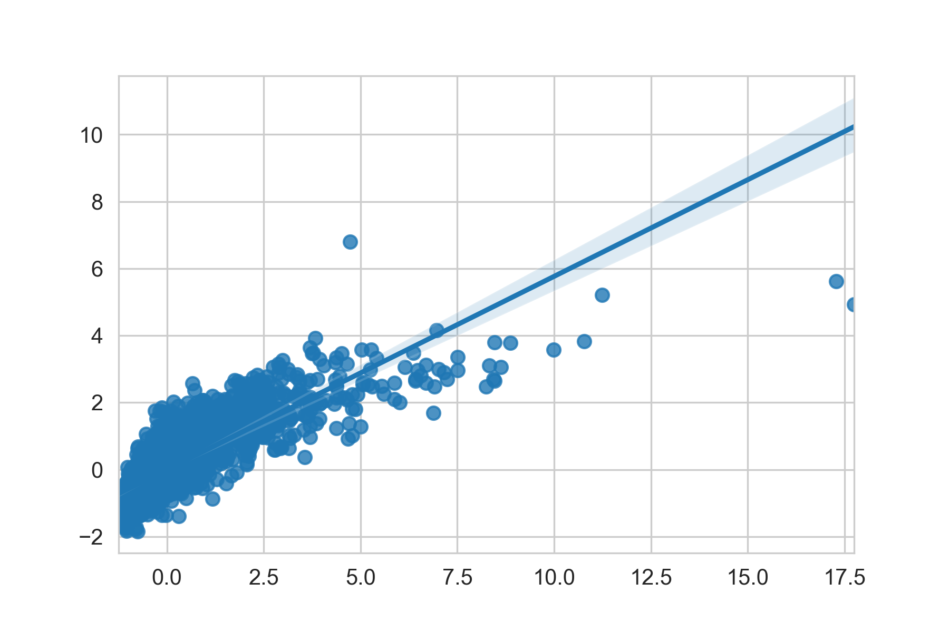
The predictive model
Linear Regression Model, R2 = 0.63
R2 = is the proportion of the variance in the dependent variable that is predictable from the independent variable

Slide 10
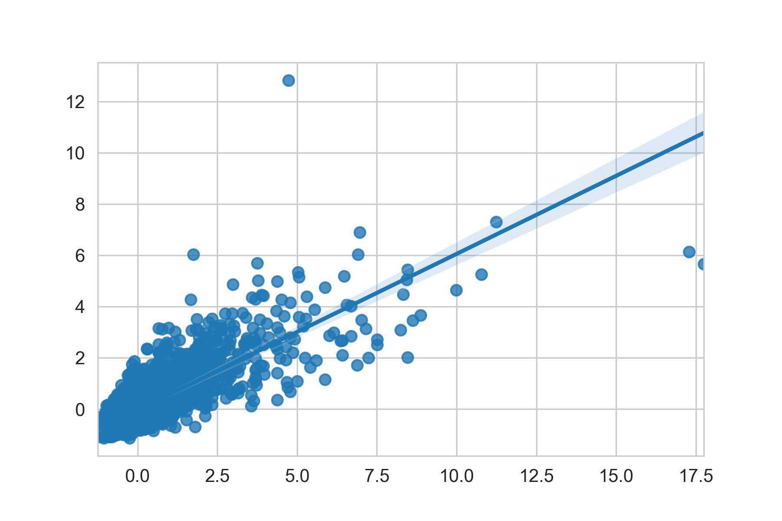
The predictive model: LRM + KNN
Linear Regression Model + KNN (K=4), R2 = 0.65

Slide 11
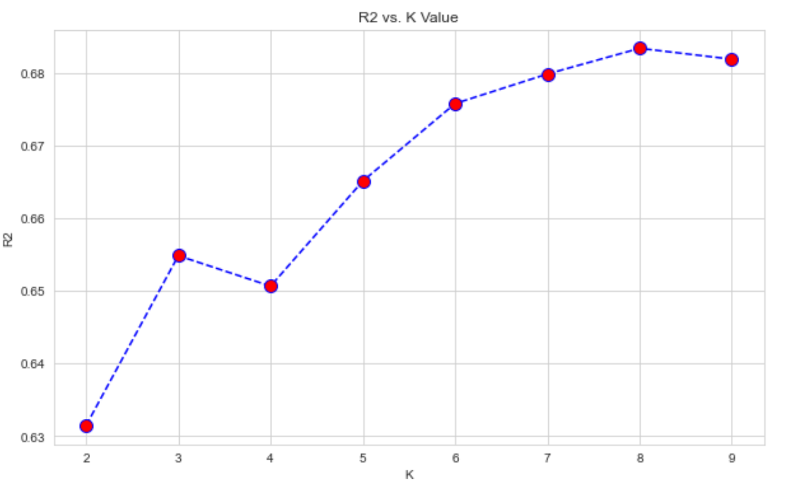
The predictive model: : LRM + KNN
Linear Regression Model + KNN (K=4), R2 = 0.65

Slide 12
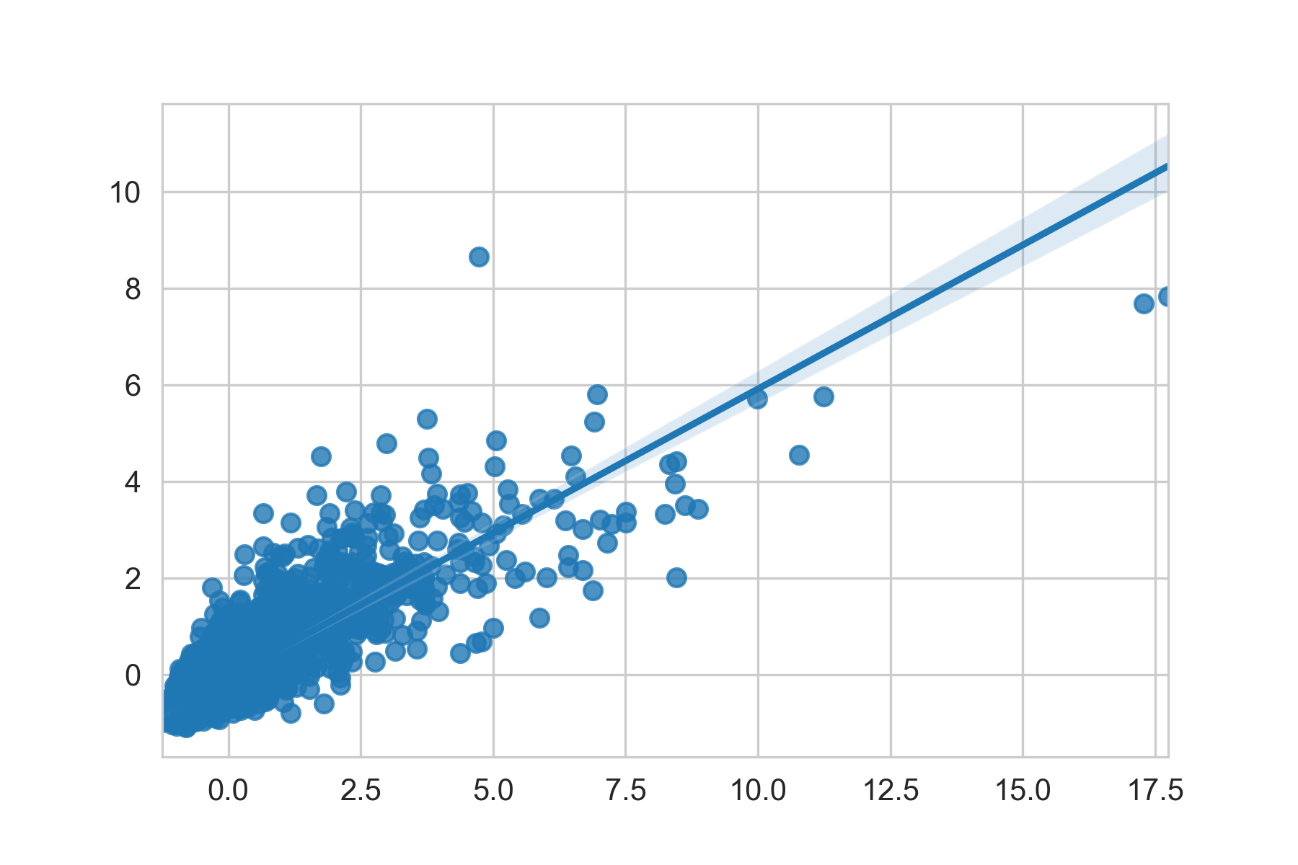
The predictive model: : LRM + KNN (K=8)
Linear Regression Model + KNN (K=8), R2 = 0.68

Slide 13
Conclusions
The best R2 scores obtained is 0.68, which means that the independent variables considered influence the variation of the price of about 68%
The low score is probably means that my feature extraction and subsetting of the dataset was faulty.
Additional variables or a more efficient subsetting of the initial dataset would have helped to better explain the variance in the housing price.

